Slide 1

Customer Behavior and Service Quality Analysis in the Restaurant Domain Using SQL
Presented By:
V . Subhash
S . Mohan Chandra
P . Praveen

Slide 2
OBJECTIVE
Restaurants have lots of customer data but don't know what it really means
Owners can't easily find out: Who loves my food? Where am I failing? What should I improve?
Important questions stay unanswered because the data is "locked" in tables
This project uses SQL to unlock and analyse the data quickly and correctly
Goal: Give restaurant owners simple, actionable ideas to get more happy customers and earn more money

Slide 3
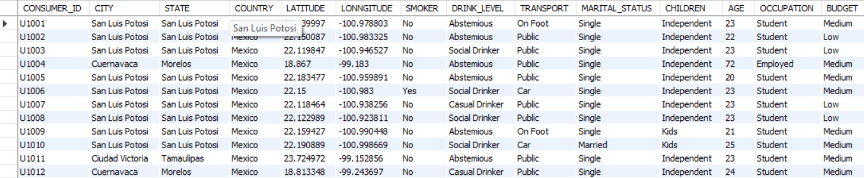
TABLES

Slide 4
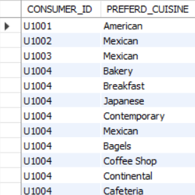
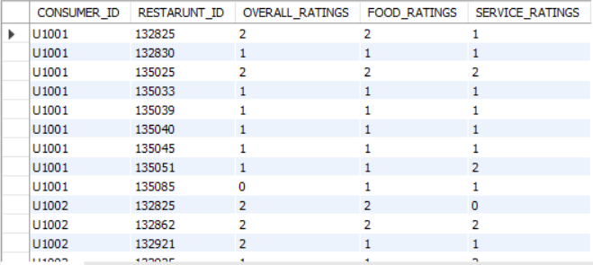
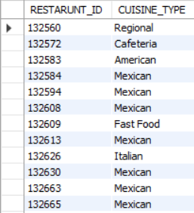
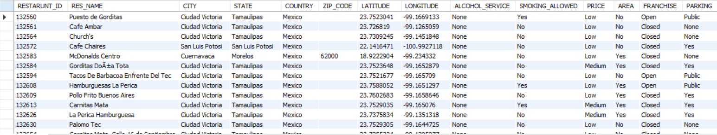

Slide 5
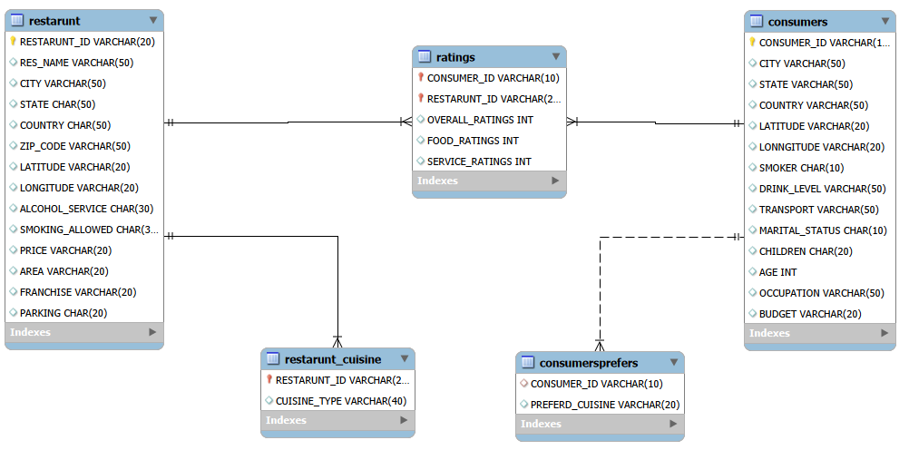
ER-Diagram

Slide 6

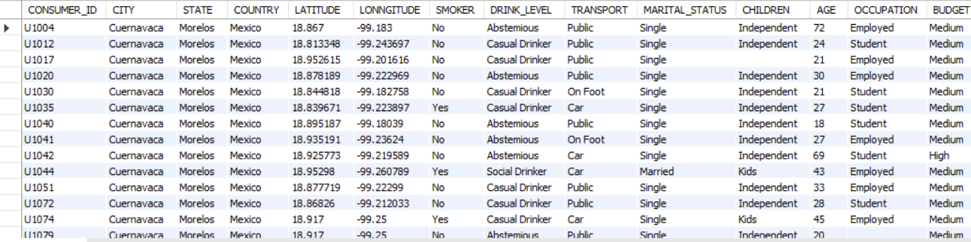
Using the WHERE clause to filter data based on specific criteria. 1)List all details of consumers who live in the city of Cuernavac.

Slide 7

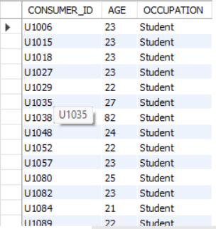
2) Find the Consumer_ID, Age, and Occupation of all consumers who are 'Students' AND are 'Smokers'.

Slide 8

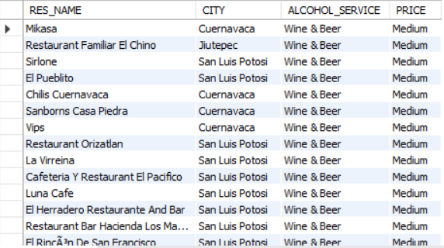
3) List the Name, City, Alcohol_Service, and Price of all restaurants that serve 'Wine & Beer' and have a 'Medium' price level.

Slide 9

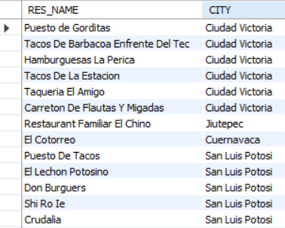
4) Find the names and cities of all restaurants that are part of a 'Franchise'.

Slide 10

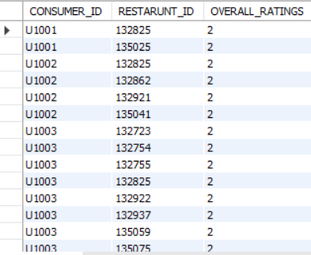
5) Show the Consumer _ ID , Restaurant _ ID , and Overall _ Rating for all ratings where the Overall _ Rating was 'Highly Satisfactory' (which corresponds to a value of 2, according to the data dictionary).

Slide 11
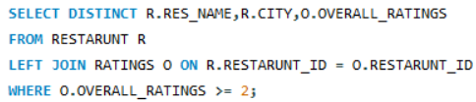
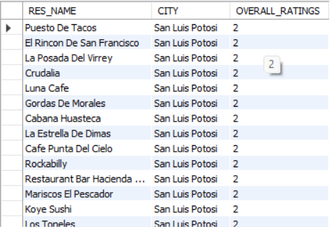
Questions JOINs with Subqueries 1) List the names and cities of all restaurants that have an Overall_Rating of 2 (Highly Satisfactory) from at least one consumer.

Slide 12
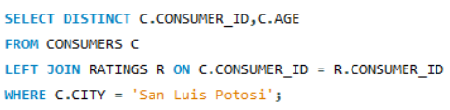
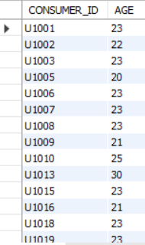
2) Find the Consumer_ID and Age of consumers who have rated restaurants located in 'San Luis Potosi'.

Slide 13
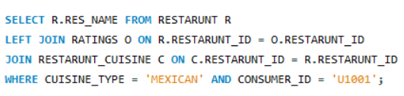

3) List the names of restaurants that serve 'Mexican' cuisine and have been rated by consumer 'U1001'.

Slide 14
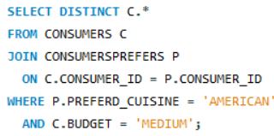
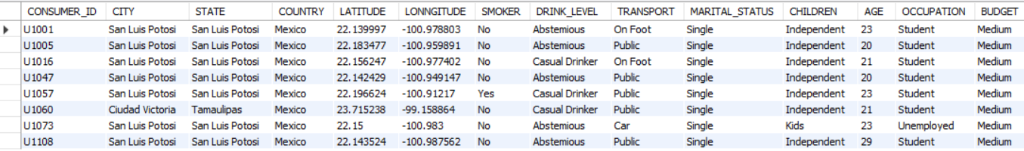
4) Find all details of consumers who prefer 'American' cuisine AND have a 'Medium' budget.

Slide 15
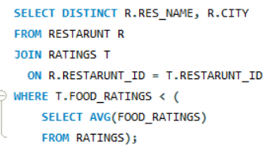
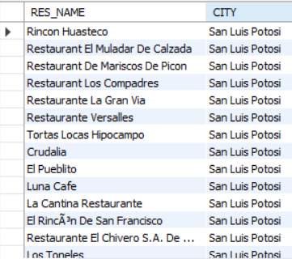
5) List restaurants (Name, City) that have received a Food_Rating lower than the average Food_Rating across all rated restaurants.

Slide 16
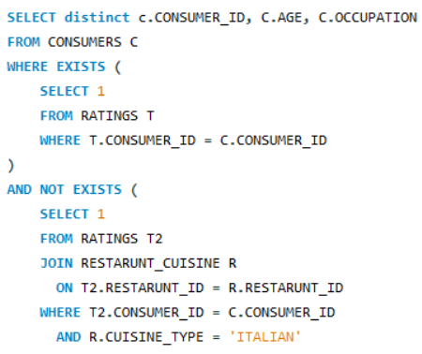
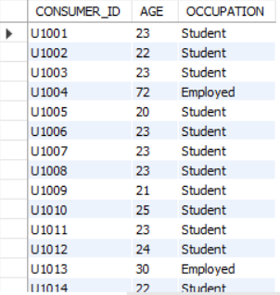
6) Find consumers (Consumer_ID, Age, Occupation) who have rated at least one restaurant but have NOT rated any restaurant that serves 'Italian' cuisine.

Slide 17
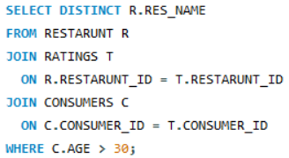
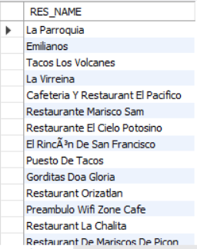
7) List restaurants (Name) that have received ratings from consumers older than 30.

Slide 18
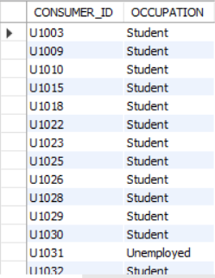
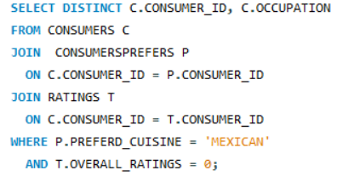
8) Find the Consumer_ID and Occupation of consumers whose preferred cuisine is 'Mexican' and who have given an Overall_Rating of 0 to at least one restaurant (any restaurant).

Slide 19
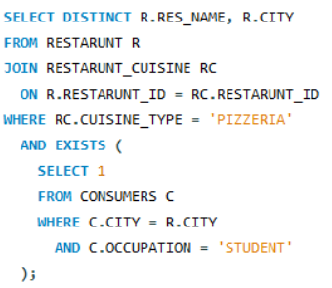

9) List the names and cities of restaurants that serve 'Pizzeria' cuisine and are located in a city where at least one 'Student' consumer lives

Slide 20
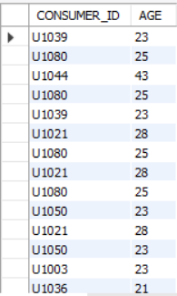
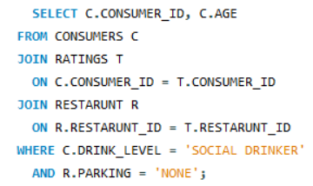
10) Find consumers (Consumer_ID, Age) who are 'Social Drinkers' and have rated a restaurant that has 'No' parking.

Slide 21
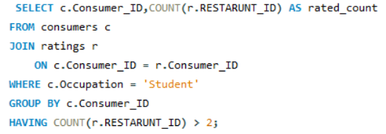
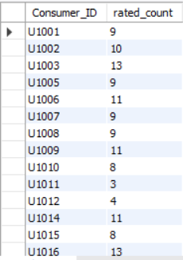
Questions Emphasizing WHERE Clause and Order of Execution 1) List Consumer_IDs and the count of restaurants they've rated, but only for consumers who are 'Students'. Show only students who have rated more than 2 restaurants.

Slide 22
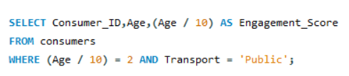
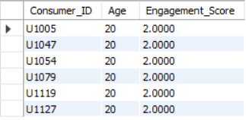
2) We want to categorize consumers by an 'Engagement_Score' which is their Age divided by 10 (integer division). List the Consumer_ID, Age, and this calculated Engagement_Score, but only for consumers whose Engagement_Score would be exactly 2 and who use 'Public' transportation.

Slide 23
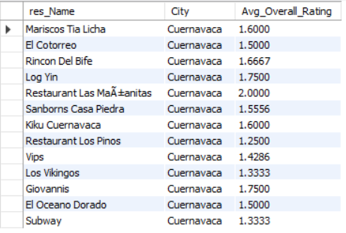
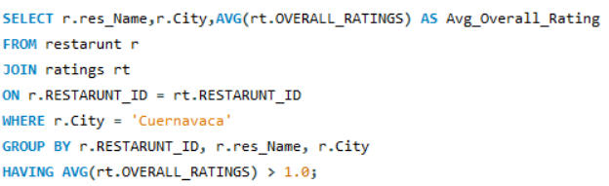
3)For each restaurant, calculate its average Overall_Rating. Then, list the restaurant Name, City, and its calculated average Overall_Rating, but only for restaurants located in 'Cuernavaca' AND whose calculated average Overall_Rating is greater than 1.0.

Slide 24
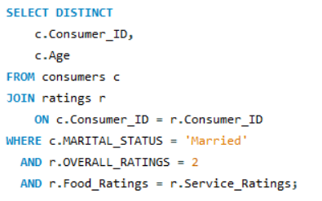
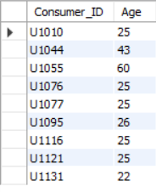
4) Find consumers (Consumer_ID, Age) who are 'Married' and whose Food_Rating for any restaurant is equal to their Service_Rating for that same restaurant, but only consider ratings where the Overall_Rating was 2

Slide 25
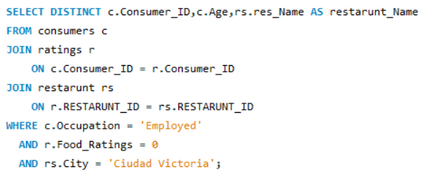

5) List Consumer_ID, Age, and the Name of any restaurant they rated, but only for consumers who are 'Employed' and have given a Food_Rating of 0 to at least one restaurant located in 'Ciudad Victoria'.

Slide 26
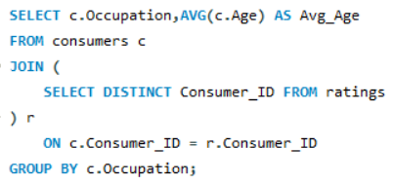
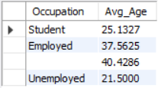
Advanced SQL Concepts: Derived Tables, CTEs, Window Functions, Views, Stored Procedures 1) For each Occupation, find the average age of consumers. Only consider consumers who have made at least one rating. (Use a derived table to get consumers who have rated).

Slide 27
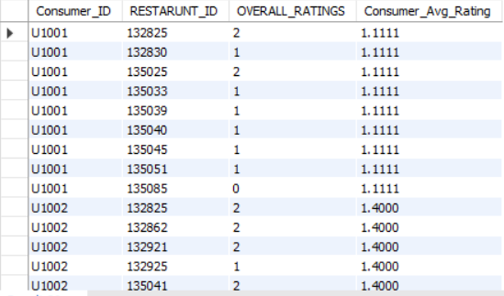
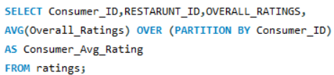
2) For each rating, show the Consumer_ID, Restaurant_ID, Overall_Rating, and also display the average Overall_Rating given by that specific consumer across all their ratings.

Slide 28
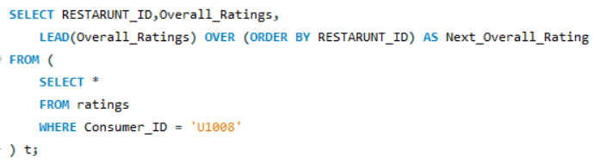
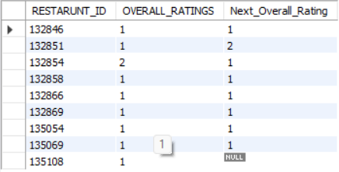
3) Consider all ratings made by 'Consumer_ID' = 'U1008'. For each rating, show the Restaurant_ID, Overall_Rating, and the Overall_Rating of the next restaurant they rated (if any), ordered by Restaurant_ID (as a proxy for time if rating time isn't available). Use a derived table to filter for the consumer's ratings first.

Slide 29
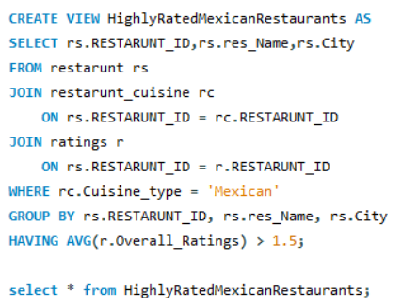
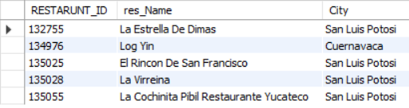
4) Create a VIEW named HighlyRatedMexicanRestaurants that shows the Restaurant_ID, Name, and City of all Mexican restaurants that have an average Overall_Rating greater than 1.5.

Slide 30
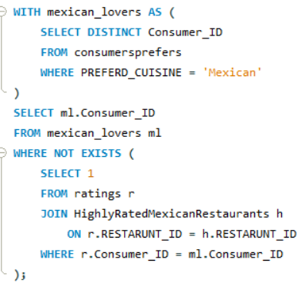
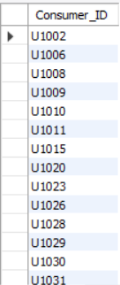
5) First, ensure the HighlyRatedMexicanRestaurants view from Q7 exists. Then, using a CTE to find consumers who prefer 'Mexican' cuisine, list those consumers (Consumer_ID) who have not rated any restaurant listed in the HighlyRatedMexicanRestaurants view.

Slide 31
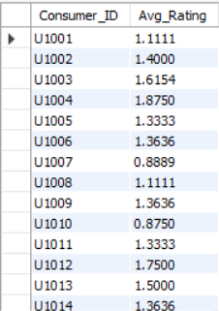
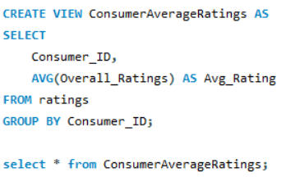
6) First, create a VIEW named ConsumerAverageRatings that lists Consumer_ID and their average Overall_Rating.

Slide 32
Final business insights and recommendations
Students are the most engaged consumers but are highly price-sensitive making affordability and value offerings critical.
Consumers above 30 provide more consistent and reliable ratings, serving as a strong indicator of true restaurant quality.
Mexican cuisine is widely popular but highly competitive, with only a few restaurants achieving consistently high ratings.
Franchise restaurants deliver stable experiences but lack differentiation, limiting their ability to stand out on quality.
Location and non-food factors such as parking and city demographics significantly influence restaurant ratings and customer satisfaction.

Slide 33
Challenges working on SQL
Designing efficient Views and Stored Procedures required careful structuring to avoid performance issues.
Complex joins across multiple tables required careful design to avoid duplicates.
Large queries with CTEs and subqueries caused performance slowdowns.
Interpreting business meaning from numeric ratings required careful validation.
Ensuring correct results during multi-level filtering and subquery conditions was challenging.

Slide 34
CONCLUSION
The SQL queries collectively demonstrate how relational data across consumers, restaurants, cuisines, and ratings can be used to derive meaningful business insights.
By applying WHERE clauses, JOINs, subqueries, aggregations, CTEs, window functions, views, and stored procedures, the analysis successfully identifies key consumer segments, evaluates restaurant performance, and uncovers patterns in preferences and satisfaction.
Overall, these queries show that structured SQL analysis is an effective foundation for data-driven decision-making, enabling businesses to optimize customer targeting, improve restaurant quality, and enhance overall platform performance.

Slide 35

THANK YOU

